Slide 1
The Discrete Fourier Transform Chapter 8
Content and Figures are from Discrete-Time Signal Processing, 2e by Oppenheim, Shafer, and Buck, ©1999-2000 Prentice Hall Inc.

Slide 2
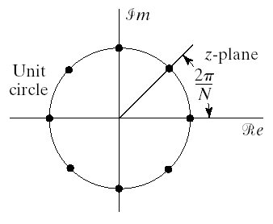
Sampling the Fourier Transform
Consider an aperiodic sequence with a Fourier transform
Assume that a sequence is obtained by sampling the DTFT
Since the DTFT is periodic resulting sequence is also periodic
We can also write it in terms of the z-transform
The sampling points are shown in figure
could be the DFS of a sequence
Write the corresponding sequence

Slide 3
Sampling the Fourier Transform Cont’d
The only assumption made on the sequence is that DTFT exist
Combine equation to get
Term in the brackets is
So we get

Slide 4
Relation between Finite-length and Periodic Signals
Consider finite length signal x[n] spanning from 0 to N-1
Convolve with periodic impulse train
The Fourier transform of the periodic sequence is
This implies that
DFS coefficients of a periodic signal can be thought as equally spaced samples of the Fourier transform of one period

Slide 5
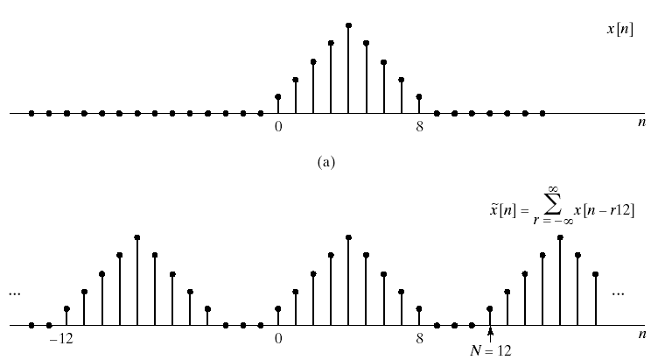
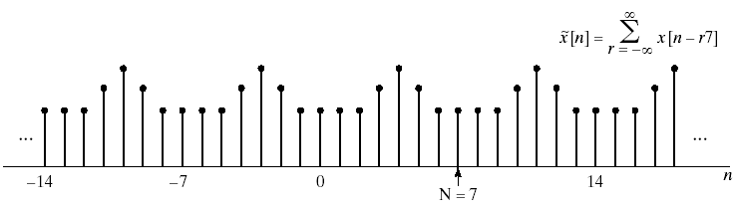
Sampling the Fourier Transform Cont’d

Slide 6
The Discrete Fourier Transform
Consider a finite length sequence x[n] of length N
For given length-N sequence associate a periodic sequence
The DFS coefficients of the periodic sequence are samples of the DTFT of x[n]
Since x[n] is of length N there is no overlap between terms of x[n-rN] and we can write the periodic sequence as
To maintain duality between time and frequency
We choose one period of as the Fourier transform of x[n]

Slide 7
The Discrete Fourier Transform

Slide 8
The Discrete Fourier Transform Cont’d
The DFS pair
The equations involve only on period so we can write
The Discrete Fourier Transform
The DFT pair can also be written as

Slide 9
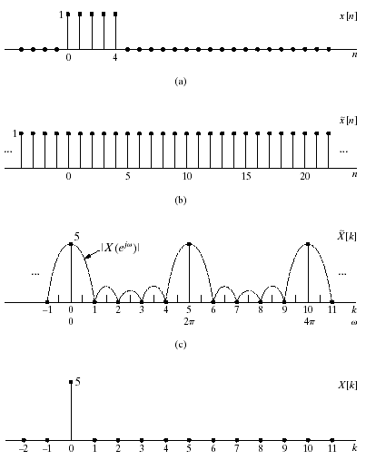
Example
The DFT of a rectangular pulse
x[n] is of length 5
We can consider x[n] of any length greater than 5
Let’s pick N=5
Calculate the DFS of the periodic form of x[n]

Slide 10
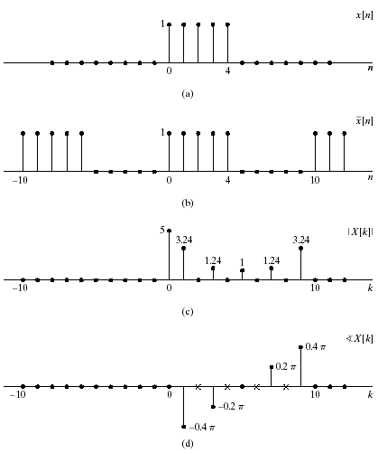
Example Cont’d
If we consider x[n] of length 10
We get a different set of DFT coefficients
Still samples of the DTFT but in different places

Slide 11
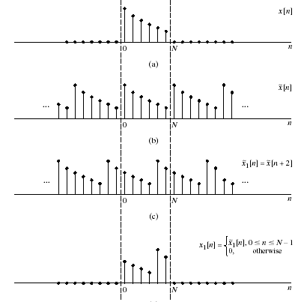
Properties of DFT
Linearity
Circular Shift of a Sequence

Slide 12
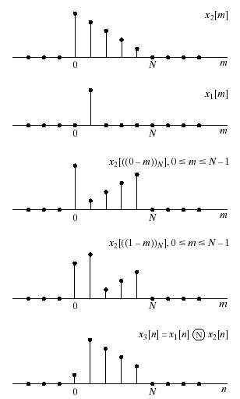
Circular Convolution
Circular convolution of of two finite length sequences

Slide 13
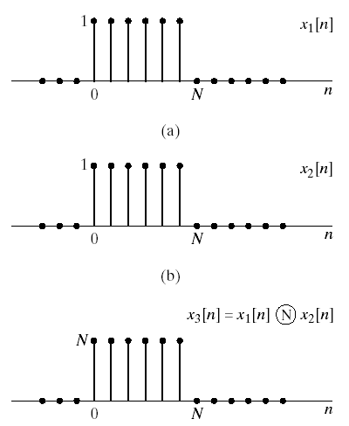
Example
Circular convolution of two rectangular pulses L=N=6
DFT of each sequence
Multiplication of DFTs
And the inverse DFT

Slide 14
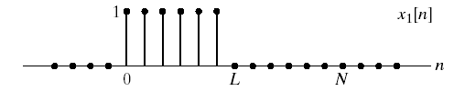

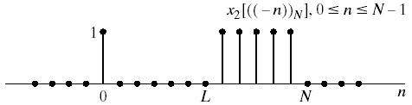
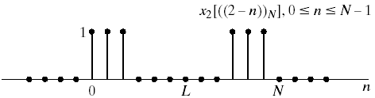
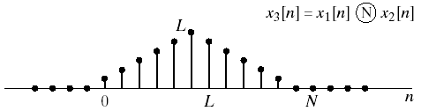
Example
We can augment zeros to each sequence N=2L=12
The DFT of each sequence
Multiplication of DFTs

Slide 15
Review
Discrete Fourier Series Pair
Discrete Fourier Transform Pair

Slide 16
Linear Convolution Using DFT

Slide 17
Linear Convolution Using DFT

Slide 18
Linear Convolution Using DFT

Slide 19
LTI Systems Using DFT

Slide 20
LTI Systems Using DFT Block Convolution Techniques

